Slide 1



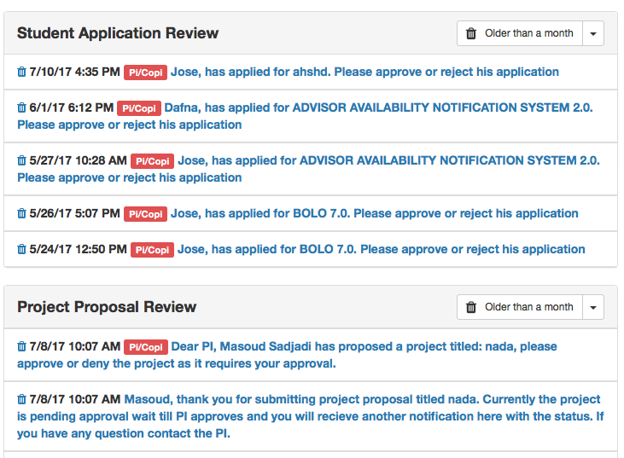
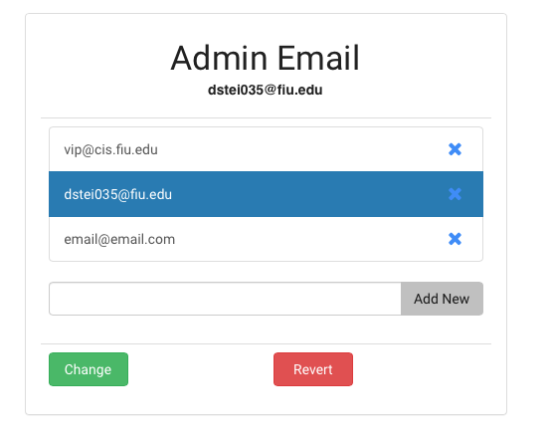
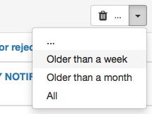
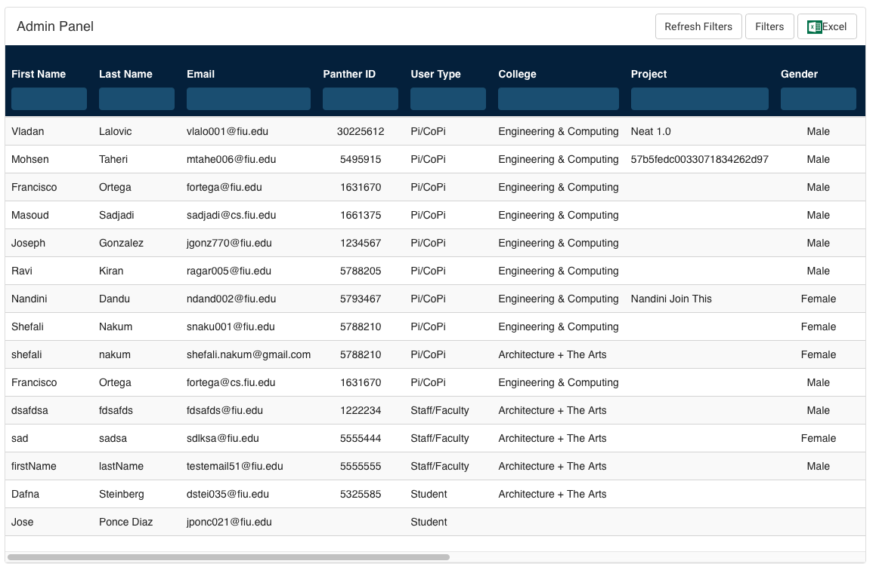

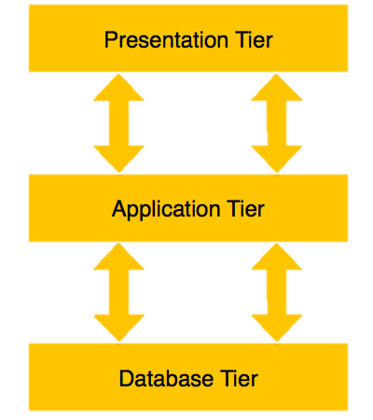



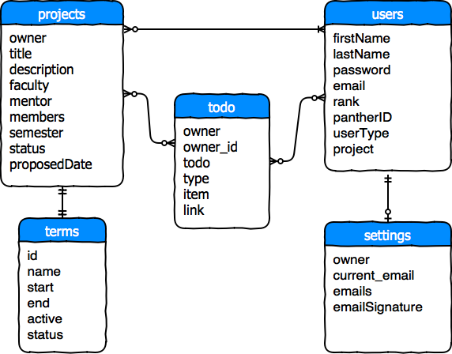

School of Computing & Information Sciences
Senior Project, 2017, Summer C
VIP Website 6.0
Student: Dafna Steinberg, Florida International University
Mentor: Francisco Ortega, Florida International University
Instructor: Masoud Sadjadi, Florida International University
Problem
Solution
Current System
Admin workflow cumbersome due to bad UX design
No front-end accessibility to admin settings
Current to-do system bloated and poorly managed
Introduce new settings interface into the system
Simplify to-do management by adding new methods of dismissing tasks
Enhanced to-do system with new capabilities
New in-app features to configure admin settings
Improved appearance and behavior of admin table
Figure 1: To-Do Inbox
Combo button and drop-down for faster cleaning
Figure 2: Admin Table Improvements
Figure 3: Admin Email Pane
Before
After
Requirements
System Design
Implementation
“Admin Email” settings can be viewed, modified, and saved via the admin panel
Admin table inputs no longer shrink to an unreadable size.
Users able to clear to-dos en-masse. (All, or by age criteria)
Pi/CoPi to-dos are automatically detected and removed from the inbox whenever the appropriate task is handled.
Three-Tiered Architecture
M
NoSQL Database
Model-View-Controller
E
App Framework
Model
A
View
Controller
N
JavaScript Framework
JavaScript Runtime
Verification
Object Design
Summary
Test ID: VIP-1272-G1 - Matching and removal of todos
Description: User accepts or rejects a project on the project proposal page. System matches selected project to a “to-do”. Matched task is auto- removed from the user’s inbox.
Improvements to user workflow primarily implemented via front-end development
Minimal modification to API and database reduces conflicts with pre-existing data
Expected Result: correct to-do removed from user’s inbox. Other to-dos remain
Status: PASS
Acknowledgement
The material presented in this poster is based upon the work supported by Professor Sadjadi and Ortega. I am thankful to the help that I received from my group member Jose Ponce Diaz.
Notes:
1

